Slide 1
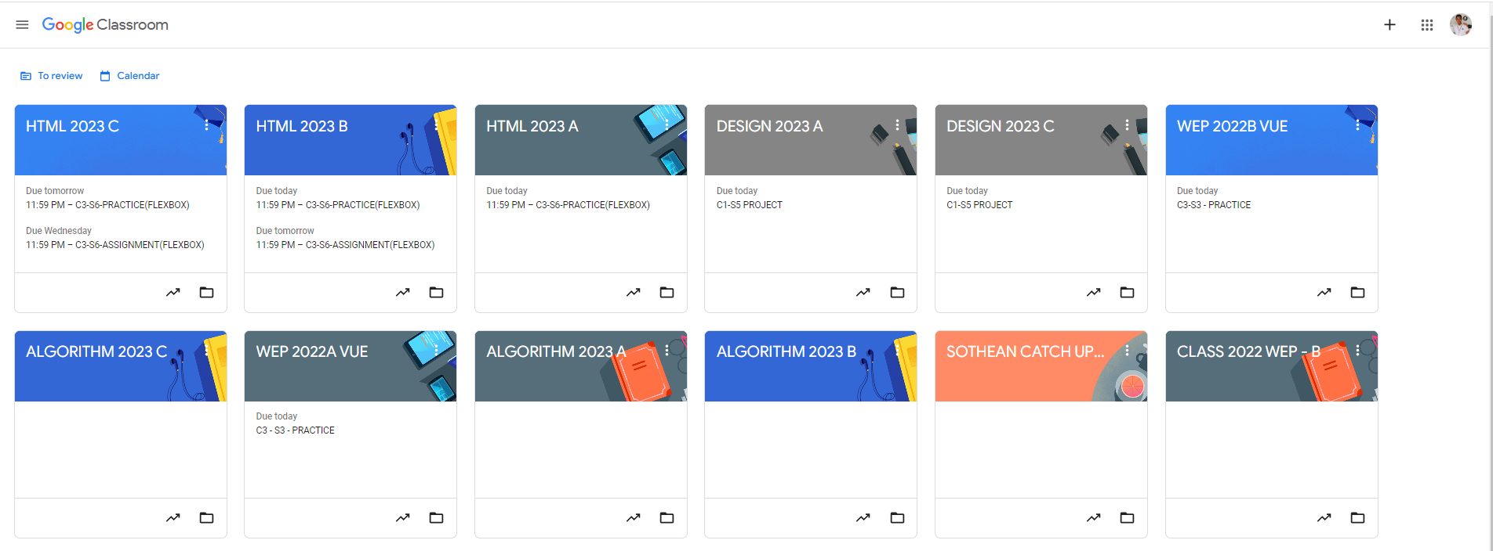
Identify root components of website below

Slide 2
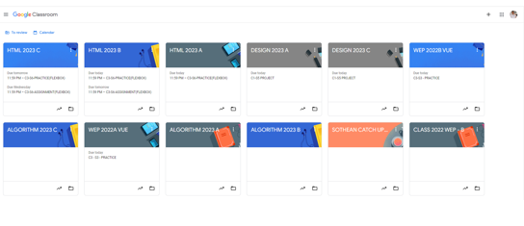
flex:0 nav
Flex:0 header
Flex:1 content

Slide 3
Flex 1
Flex 2
Nav-left
Nav-right

Slide 4
nav=-left
Nav-right
icon
logo
icon
icon
icon

Slide 5
Div 1
Div 2

Slide 6
Div 1
Div 2
icon
text
icon
text

Slide 7
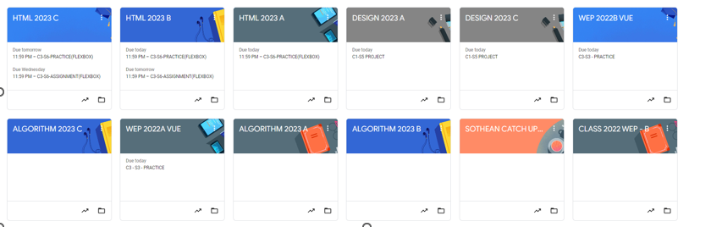

Slide 8
Card 1
Card 2
Card 3
Card 4
Card 5
Card 6
Card 7
Card 8
Card 9
Card 10
Card 11
Card 12

Slide 9

Card-header
Flex 1.5
Card-body
Flex 2
Flex 1
Card-footer

Slide 10
Card-title
icon
Card-content
Card-content
icon
icon

